Slide 1
Publisher to PowerPoint Python Script Documentation

Slide 2
Table of Contents
Click each header to navigate to that section
Script Purpose & Functionality ..........................................................
How to Install & Run Demo .............................................................
Set Up for Task Scheduler .................................................................
Set Up Desktop Shortcut ..................................................................
Troubleshooting ...............................................................................
Changelog .......................................................................................
Click this icon to navigate to Table of Contents page

Slide 3
Script Purpose and Functionality
Why was this tool/script made?
In the wake of Publisher being obsoleted come October 2026, a solution was needed to “convert” these files from Publisher to another editable format. Other online means and tools were explored but nothing yielded the desired results. Therefore, this tool was made.
What does it do? Effectively, it “looks” at a selected Publisher file and goes through page-by-page, asset-by-asset to “copy” the details and text as closely as possibly and paste it to a new PowerPoint file. Although still plagued with some needed fixes, 80% is still passable. Why should I use this over something else? This tool is just the one made internally at Wieland/New Haven to satisfy our needs with the timeline we have. Should any alternative tools be presented then feel free to explore those. The intention with this tool is to preserve editability and spare anyone making SOPs from re-making them.
This tool was a fun challenge, but very rewarding to see come to fruition. I will strive to support any and all tools I develop, and anyone brave enough to use them.
- Dante

Slide 4
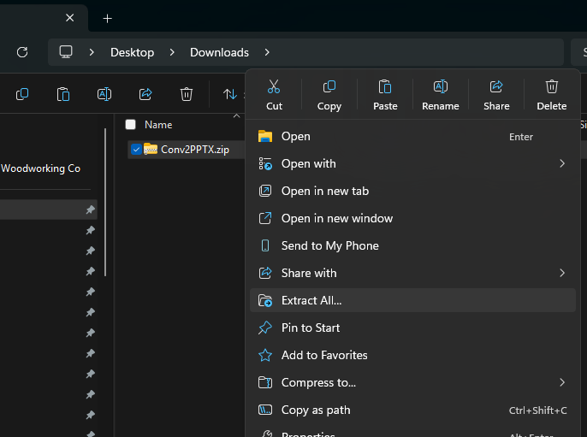
How to Install & Run Demo
1. Click the folder icon below to download the .zip file.
2. Once downloaded use the “Extract All” command on the .zip file.
3. Once extracted, It is recommended to move the new folder to the desired “work folder”
- TIP: Don’t bury the folder deep in a network drive, Windows has a file path character limit (206). Recommended on Desktop or high level on a network drive.

Slide 5
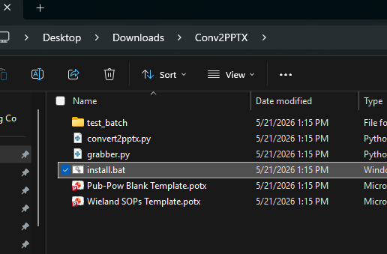
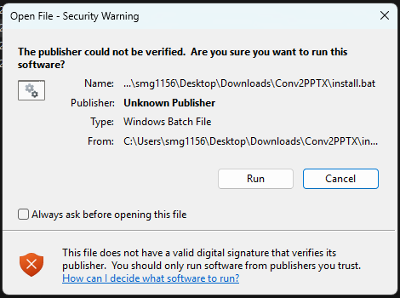
How to Install & Run Demo
4. Open the folder and find the install.bat file. Double-click to run this Powershell program.
This will verify and prompt the user to install any required softwares or packages required to run the Python script.
5. A Warning Window will pop-up, Uncheck the box next to “Always ask before ...”, and click Run to Proceed.

Slide 6
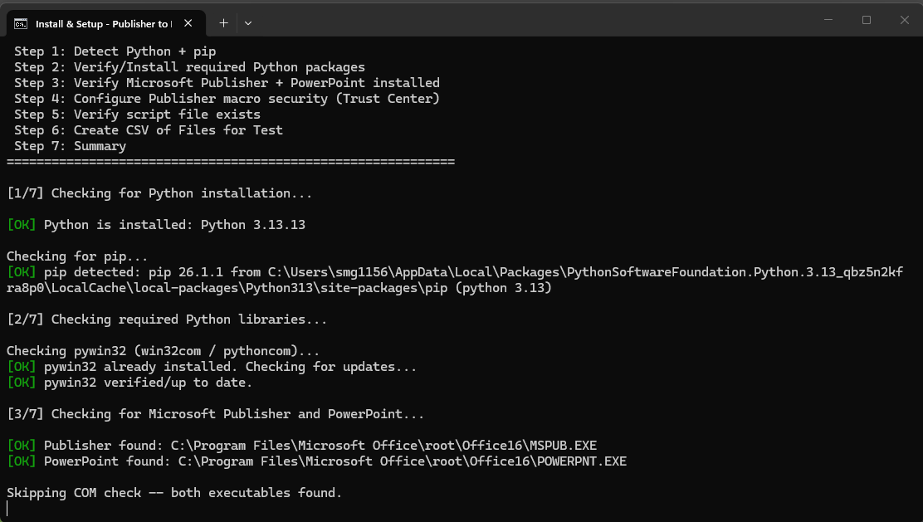
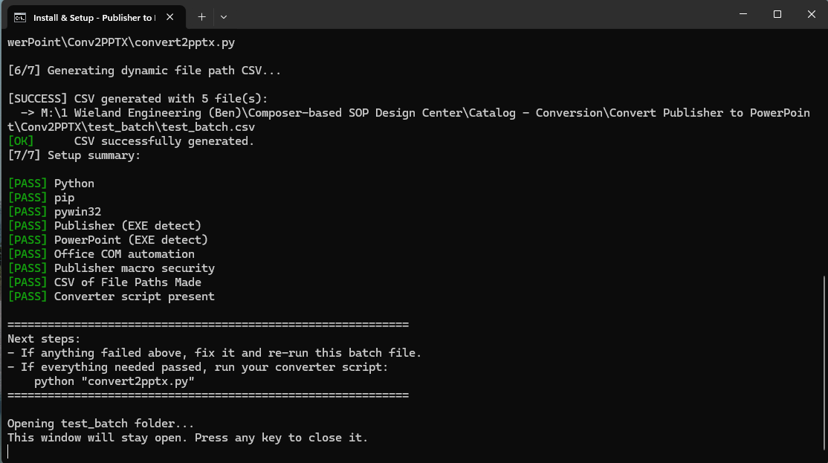
How to Install & Run Demo
6. A terminal window will pop-up displaying the batch file in action.
7. Ideal outcome should be all green [PASS], if any [FAIL] follow the terminal prompts or see Troubleshooting section.

Slide 7
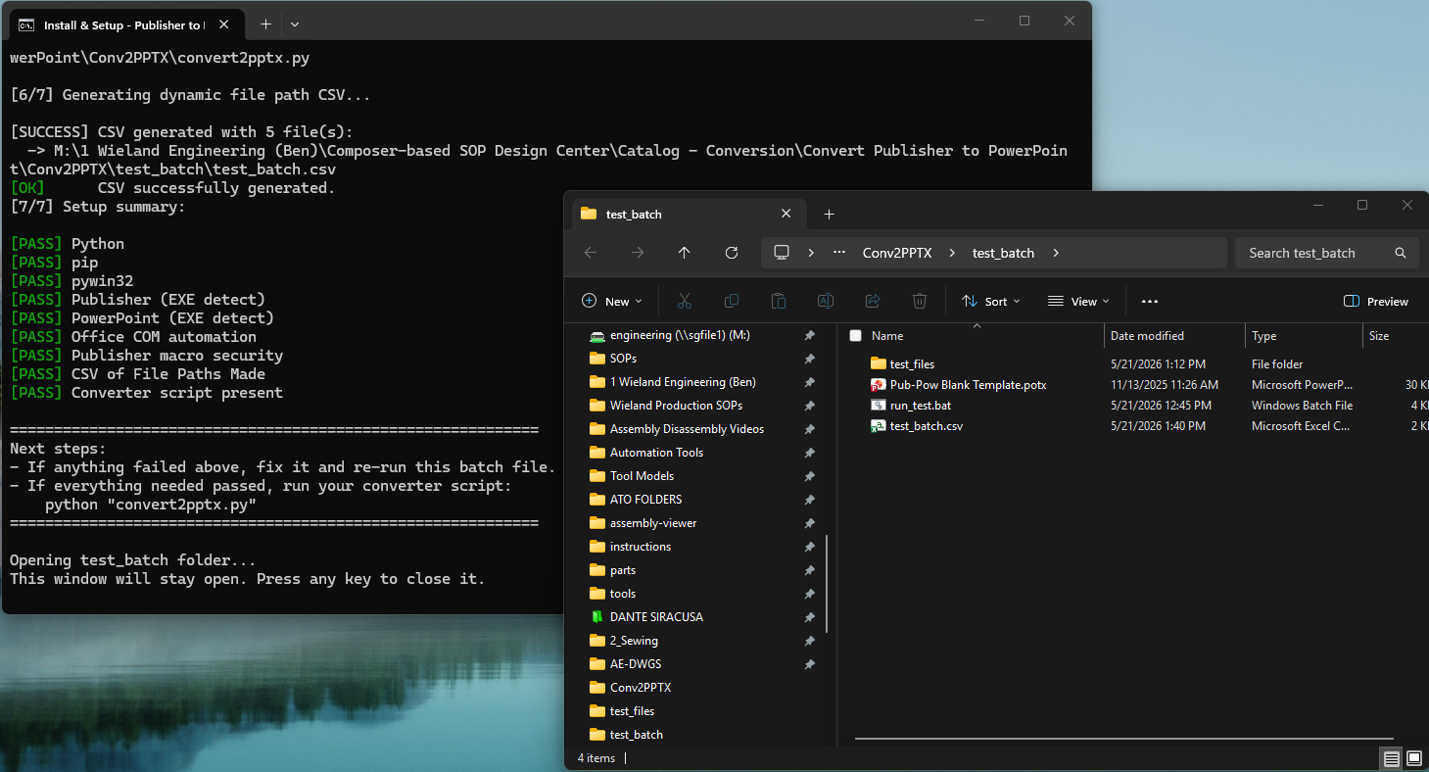
How to Install & Run Demo
8. A window will pop up opening the test_batch folder once install.bat is completed.
Continue to next page →

Slide 8
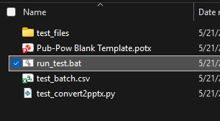
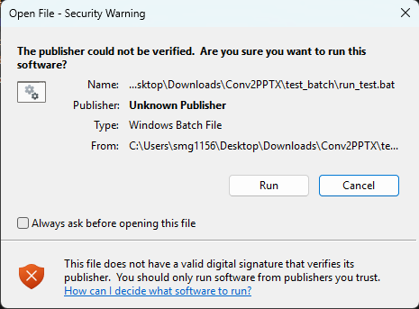
How to Install & Run Demo
9. Find the test_run.bat file and double-click to run that PowerShell program.
10. A Warning Window will pop-up, Uncheck the box next to “Always ask before ...”, and click Run to Proceed.

Slide 9
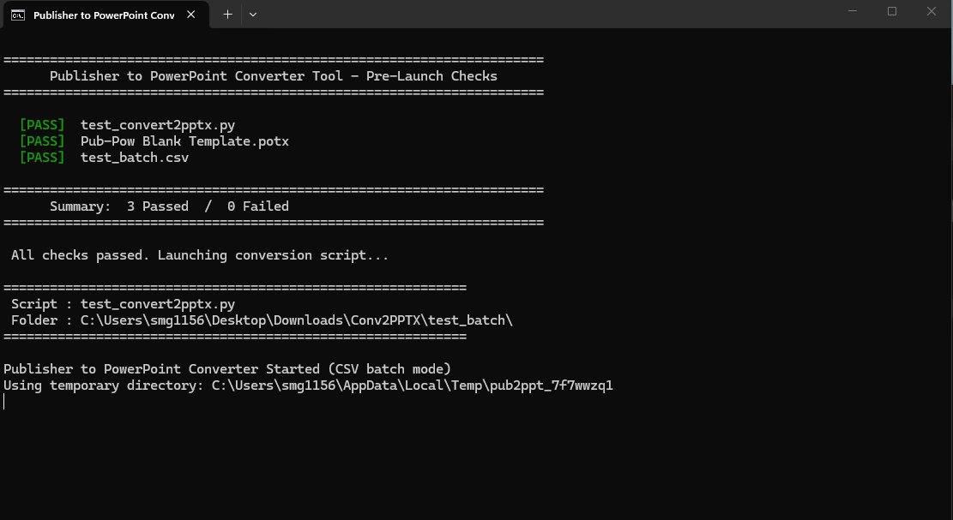
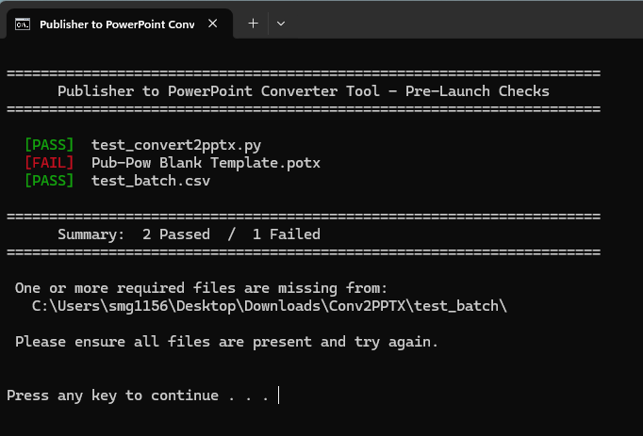
How to Install & Run Demo
11. Another terminal window will open, ensuring that all the required files are available before running the test conversion.
12. In the event of a [FAIL], follow the prompts from the Terminal, or go to the Troubleshooting section.

Slide 10
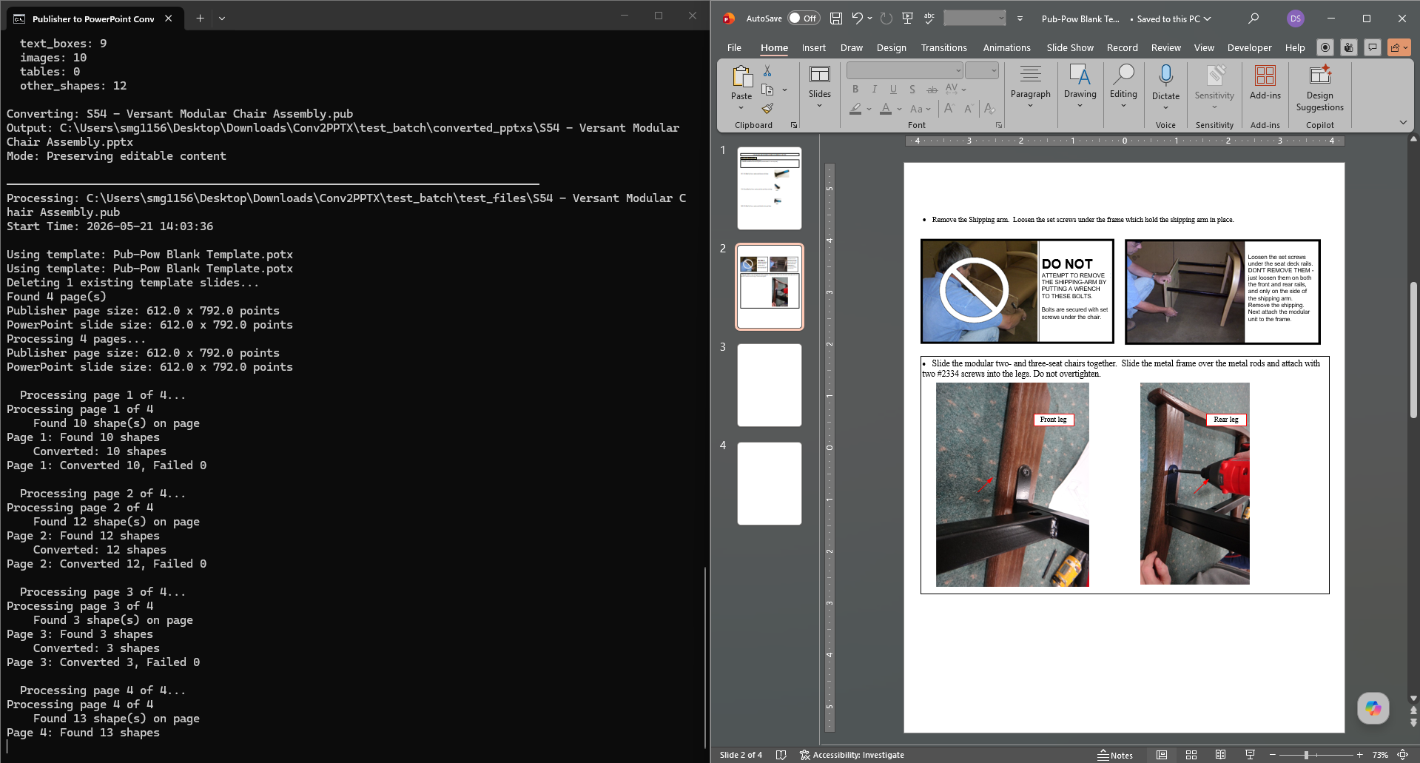
How to Install & Run Demo
13. Once up and running, a new instance of PowerPoint should appear and assets should be inserted into their respective locations.
The video linked below shows the (demo running without faults)

Slide 11
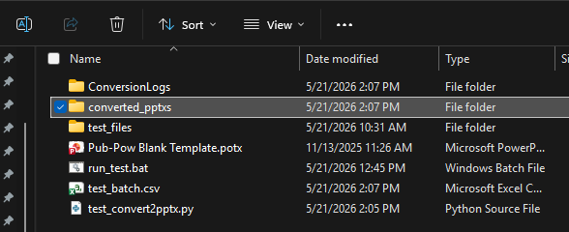
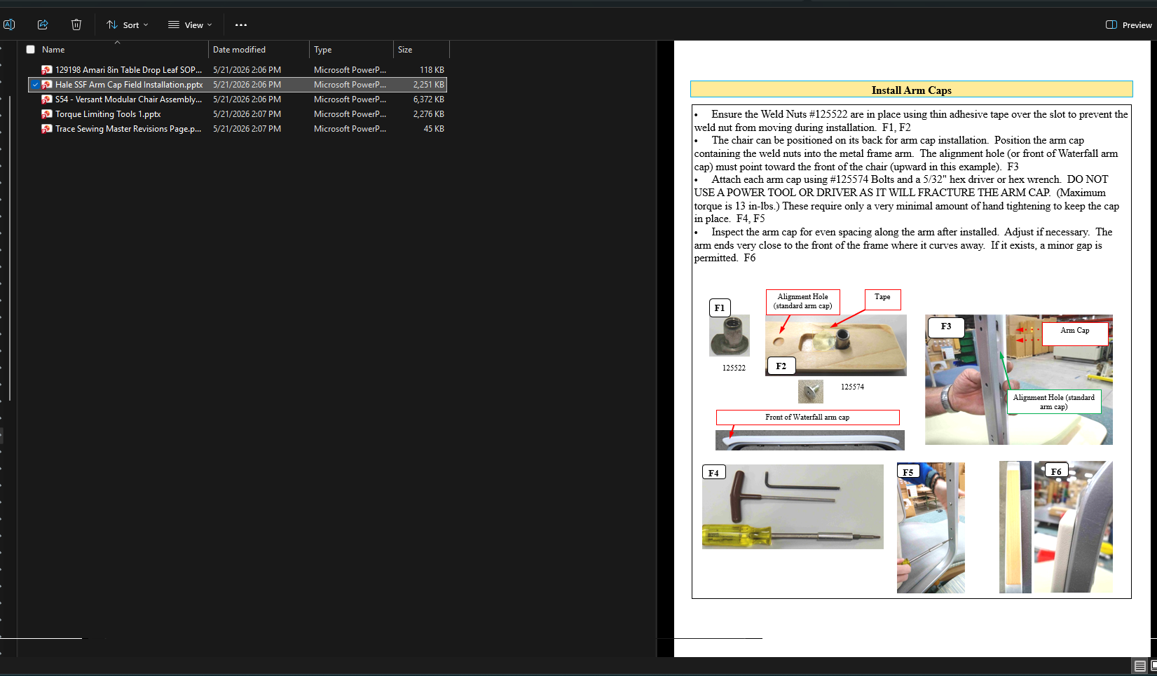
How to Install & Run Demo
14. Once completed, a new folder titled converted_pptxs is now available in the test_batch folder.
15. Finally, inspect the converted .PPTXs files as needed.

Slide 12
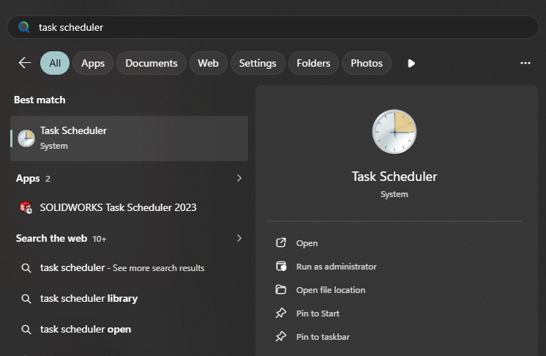
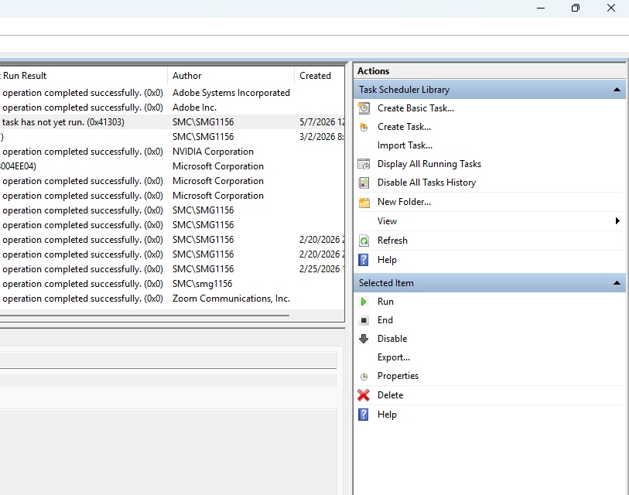
Set Up for Task Scheduler
1. Search “Task Scheduler” in the Start Menu and open the app shown.
2. Select “Create a Task” in the top right corner of the window.

Slide 13
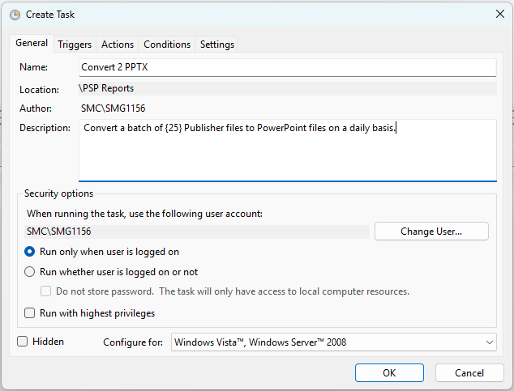
Set Up for Task Scheduler
3. Fill out the respective fields for each tab:
Name: Convert 2 PPTX
Description: Convert a batch of {25} Publisher files to PowerPoint files on a daily basis.
4. Navigate to the Triggers tab and click New

Slide 14
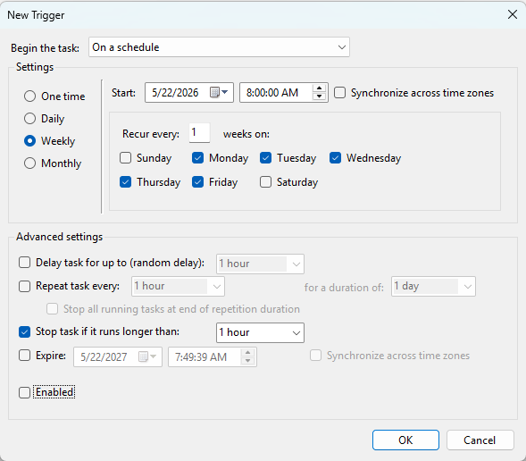
Set Up for Task Scheduler
5. User can configure these settings as desired, but here’s the recommended settings
Begin the task: On a schedule
Weekly: Monday thru Friday
Start: Today 8:00 am
Stop Task if it runs longer than:1 hour
6. Navigate to the Actions tab and click New

Slide 15
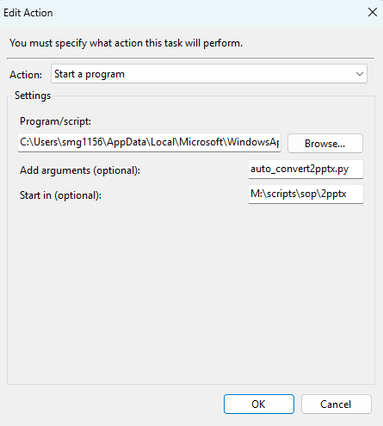
Set Up for Task Scheduler
7. Navigate to the Actions tab and click New
Action: Start a program
Program/script: C:\Users\{YOUR C-DRIVE/USER NAME}\AppData\Local\Microsoft\WindowsApps\python.exe
Add arguments: auto_convert2pptx.py
Start in: C:\Users\smg1156\Desktop\AutoCAD
{Replace with folder where your script lives.}
8. Click Ok to close window.

Slide 16
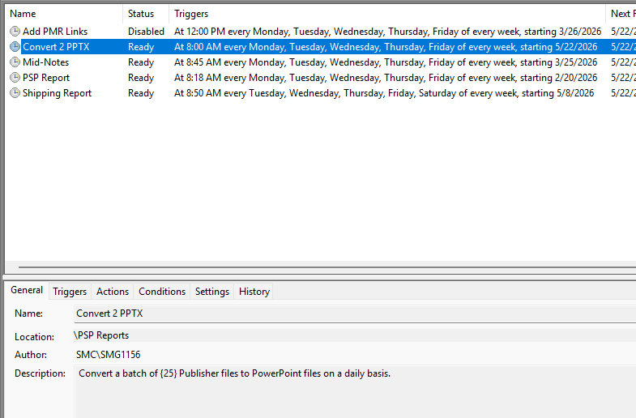
Set Up for Task Scheduler
9. Click OK once again to complete creating a new task.
See Troubleshooting for additional information.

Slide 17
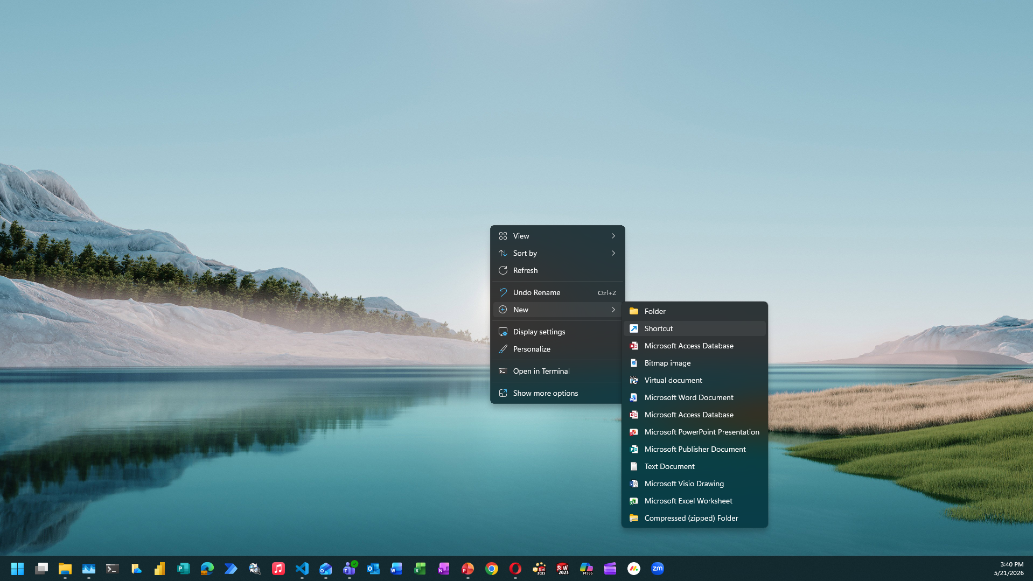
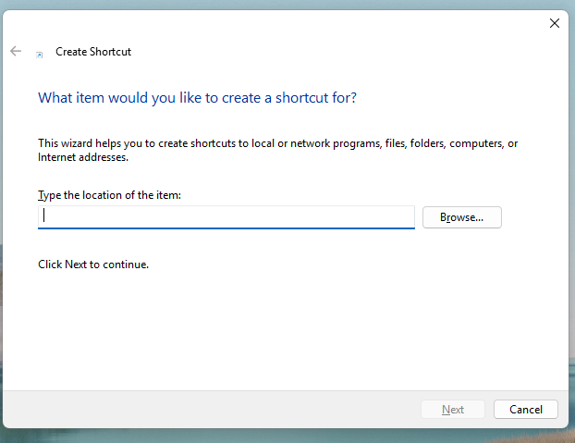
Set Up Desktop Shortcut
1. Go to Desktop, right-click and select New > Shortcut
2. A window will pop-up prompting you to enter a file path for a program.

Slide 18
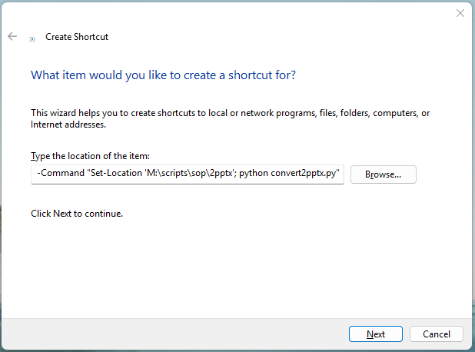
Set Up Desktop Shortcut
3. Use the text below as reference for what to type in to that field:
powershell -NoExit -Command "Set-Location 'M:\scripts\sop\2pptx'; python convert2pptx.py"
4. Once entered, click Next to proceed.

Slide 19
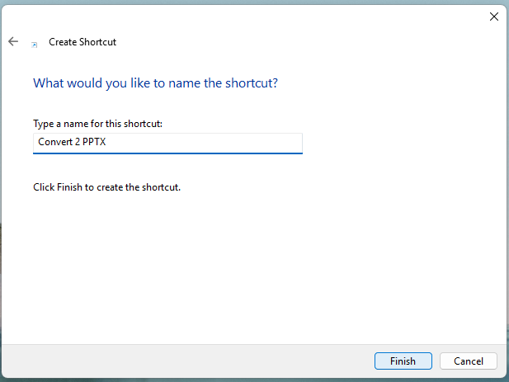
Set Up Desktop Shortcut
5. You will be prompted to make a name for this shortcut, it is recommended to make it recognizable.
4. Once entered, click Finish to complete.

Slide 20
Troubleshooting
How to Quit/Stop Running the Script
In any variation of this script/tool use CTRL+C after clicking on/focusing the terminal window to abort the script.
A secondary close if that doesn’t work, is to completely close the terminal window using the typical window control features in the top-right of any window.
Assets are Messed Up
It is likely that some things slipped through the cracks and I could not get a complete 1:1 conversion of all Publisher assets to go to PowerPoint.
For the more obvious “failures”, I’ll do my best to update the script/tool in a timely fashion.
A changelog at the end of this document will be updated with any changes made in the future.
The downloadable zip file will be updated in tandem.
80% is still passable
Contact Dante for Support
If this document was completely useless in setup and troubleshooting, send me a message or give me a call and I’ll do my best to get everything sorted out with you.

Slide 21
Troubleshooting
[FAILS] on install.bat
If for Python, you should have been directed to the Microsoft store to download Python 3.13.
Once installed, re-run install.bat
If for pip or pywin32, you may have received additional directions in the terminal to “download updated version”.
Follow terminal prompts to complete this; basically, all you’d need to do is take your mouse and highlight the “update command” and paste that into a new tab on the terminal.
[FAILS] on run_test.bat
If for test_convert2pptx.py, this is due to the program not finding the file for a couple of reasons
Wrong File Name: If the file happened to be renamed, change the name back to “test_convert2pptx.py” to ensure this demo runs properly.
File Not in Same Folder: If the file “test_convert2pptx.py” is moved, this error can be thrown. Make sure that the file is in the same folder, “next to”, the run_test.bat
If for Pub-Pow Blank Template.potx, this is due to the program not finding the file for a couple of reasons
Wrong File Name: If the file happened to be renamed, change the name back to “Pub-Pow Blank Template.potx” to ensure this demo runs properly.
File Not in Same Folder: If the file “Pub-Pow Blank Template.potx” is moved, this error can be thrown. Make sure that the file is in the same folder, “next to”, the run_test.bat
Continue to next page →

Slide 22
Troubleshooting
[FAILS] on run_test.bat
If for test_batch.csv, this is due to the program not finding the file for a couple of reasons.
File Not Created: This .CSV should have been made after the execution of install.bat. In the off chance this file doesn’t exist, simply search for grabber.py in the Conv2PPTX folder and run that script.
Wrong File Name: If the file happened to be renamed, change the name back to “test_batch.csv” to ensure this demo runs properly.
File Not in Same Folder: If the file “test_batch.csv” is moved, this error can be thrown. Make sure that the file is in the same folder, “next to”, the run_test.bat
CSV File Path Failure
This is a built-in failure to ensure that file paths are correct for the user. The “filler file path” currently in use in the auto_convert2pptx.py is meant to be replaced by the file path by the user.
To replace this file path, open auto_convert2pptx.py in Notepad.
Then CTRL+F to find # CHANGE ME” to find the original CSV_PATH to replace.
Replace “test_batch.csv” with the name and “.csv” extension of your desired file.
Continue to next page →

Slide 23
Troubleshooting
CSV File Path Failure (Continued)
In the off chance the CSV being used for processing does not contain the file path, Download the script below to generate another CSV of the files your desired SOP Folder. Then you’ll need to manipulate the content of the new CSV to be “filtered”/parsed down to only the files and file paths needed from your original CSV.
Contact Dante for Support
If this document was completely useless in setup and troubleshooting, send me a message or give me a call and I’ll do my best to get everything sorted out with you.

Slide 24
Changelog
Change Description | Editor | Date
Initial Release | DTS | 5/22/2026
Fixed CONV2PPTX.ZIP link download issue | DTS | 5/28/2026
Updated manual, auto, and test variants of the script for enhanced logic for processing. | DTS | 6/4/2026

